Slide 1
Week 2 - Types
OOP345

Slide 2
Fundamental Types
Typical Sizes: Ratio 1Byte = 8 bits
Char – 1 Byte
Int
Long int – 4 Byte
Short int – 2 Byte
Bool – 1 Byte
Float – 4 Byte
Double – 8 Byte
Long double – (at least 8 Bytes)

Slide 3
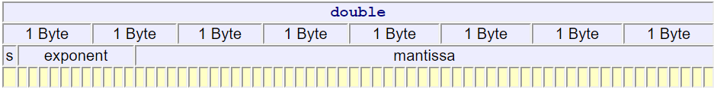
Floating Point breakdown
S = signed bit
Exponent = 2^5
Mantissa = 234^5

Slide 4
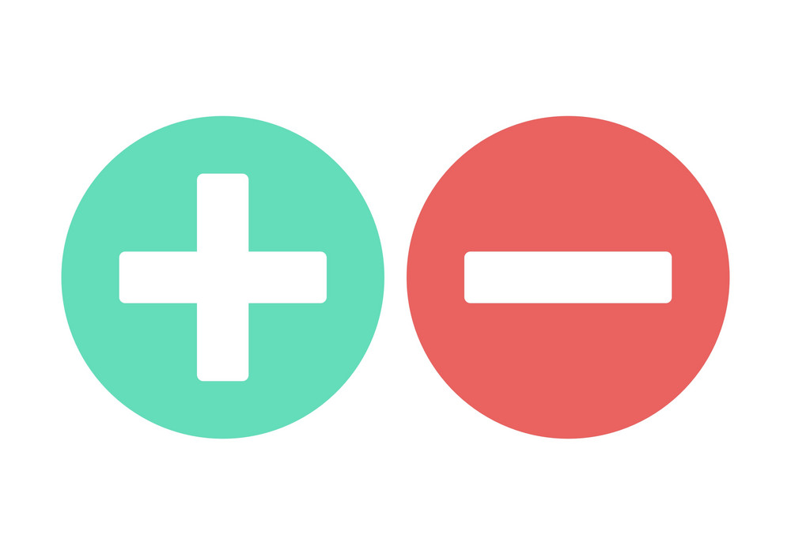
Signed / Unsigned
Signed variables allow for negative numbers
Unsigned variables cannot have negative numbers but have double the positive number capacity of a signed variable
Size example:
Signed char’s range (-128 to +127)
Unsigned char’s range (0 to 255)
Syntax:
unsigned int a = 3000000000;

Slide 5

Type Inference
Automatically detects types
Uses the “auto” keyword
Must have an initialization (must be assigned a value)
Syntax:
auto i = 0;
auto b = true;

Slide 6
Type Alignment
How much space should we create in memory for this variable?
We use alignas() to set the size in memory
We use alignof() to get the size alignment of a variable
See notes for more detail: https://ict.senecacollege.ca/~oop345/pages/content/funda.html

Slide 7

Pointers
Cannot assign pointers of different types ex. int* a = c; (c is a char *// Causes an error)
Must cast them first int * a = static_cast<int*>(c); //works ok
Wild pointers should be assigned nullptr.
Generic pointer: void * can hold an address and is not associated with any type.
When assigning from a generic you must cast the generic first.

Slide 8


References
lvalues denoted by &
Lvalues refer to regions in memory
rvalues denoted by &&
rvalues refer to:
An object near the end of their lifetime
A temporary object
A value not associated with an object

Slide 9
lvalues & rvalues cont.
We use 2 functions in the standard library to work with rvalues & lvalues
std::ref() //passes a lvalue object as param and returns a lvalue reference
std::move() //passes a lvalue object as param and returns a rvalue reference
Why use r and l values?
Copying takes a heavy amount of processing
Moving data from one address to another takes much less time and processing

Slide 10
Arrays
Arrays are continuous reserved chunks of memory for a variable type
Created in 2 ways:
int arr[5];
int* arr = new int[5];
Initializing arrays: (see weekly notes: https://ict.senecacollege.ca/~oop345/pages/content/compt.html)
Joke: Why did the programmer quit? Because he couldn’t get arrays.

Slide 11
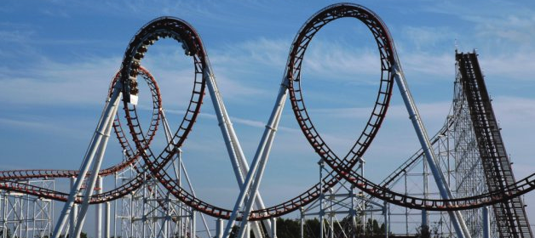
Range-Based for loops
Range based for loops iterate through a collection
int a []{1,2,3,4,5,6,7};
for (int& currentIT : a){ //currentIT is a reference to an actual int in memory
std::cout << currentIT << std::endl;
}

Slide 12

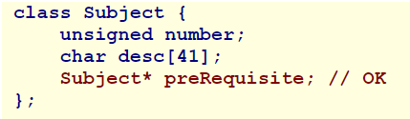
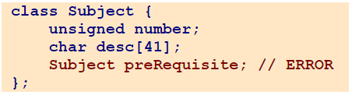
Classes
A class may have a pointer to it’s same class
A class cannot have a class by it’s same type in its members list.
Initializer lists
Subject(int inNum, char* desc): number(inNum){…}

Slide 13
Move Assignment operator(=)
Our move assignment operator works like our old one with a few changes
class School { char* name; int students; … School&& operator=(School&&); School(School&&); | School&& School::operator=(School&& src){ if (this != &src){ //good practice to see if current name has any data associated name = src.name; //name holds an address students = src.students; src.name = nullptr; src.students = 0; } return std::move(*this); // return a rvalue version of this }

Slide 14
Move Copy constructor
WE BE LAZY
The move copy constructor is similar to the non-move version
class School { char* name; int students; … School&& operator=(School&&); School(School&&); | School::School(School&& src){ *this = std::move(src); }

Slide 15
Class Variables
Class variables exist for all classes of the same class
Used to share common information across all classes
Defined with the keyword “static”
See weekly example:
https://ict.senecacollege.ca/~oop345/pages/content/class.html
Class Functions work similar to Class variables

Slide 16
Enumerations
See Notes:
https://ict.senecacollege.ca/~oop345/pages/content/class.html

